Slide 1
Towards Creative Europe
Newcastle
June 2012
Notes:
Culture deserves better in term of policy making and ressources
Investment in culture is justified for wide areas of reasons (support to innovation, to smes, to local development, to social cohesion , to make profitts , to communicate about a city , to make it attractive as a place to live)
New trends in Europea to take cultural sector more seriously in policy making - we played a part in this and by telling our journey i will tell you about CCI policy

Slide 2
KEA’s narrative on CCI policies
Measuring culture as a source of economic growth (2006 Economy of Culture in Europe)
Establishing Culture as a source of innovation (Culture based creativity -2010).
Supporting International Trade (EUCTP)
Supporting cities and regions CCI policies
Valuing impact of policy measures for CCIs (CREA-RE)
Advising European Parliament on EC structural fund policy (2014-2020)
Establishing winning ECIA consortium (DG ENT)
Mons Capital of Culture.
Notes:
This is the range of our activities since 1999 we advise on CCI policies at all level of governance.
As a research center, as a strategci consultancy, as a hub to set projects - militant for culture and CCIs
Multinational and multilingual team -in house or in partnership
Specialised in IP, culture policy and sport .
Very pro Europe

Slide 3
Industrial Design
CREATIVE INDUSTRIES AND ACTIVITIES
Consumer Electronics
Education
CULTURAL INDUSTRIES
Film and Video
Performing Arts
Books and Press
User Generated Content
Advertising
Luxury brands
CORE ARTS FIELDS
Tourism
Visual Arts
Heritage
Fashion Design
Video Games
Music
Television and Radio
Telecommu-nications
Design
Software
Architecture
RELATED SECTORS
Notes:
Influence of culture is wider - at the heart of those industries are artists, creative professionals , heritage buildings.

Slide 4
ECONOMIC CONTRIBUTION OF THE ECONOMY OF CULTURE IN EUROPE
TURNOVER
➔
The sector turned over more than €654 billion in 2003
Car manufacturing industry was € 271 billion in 2001.
ICT manufacturers was € 541 billion in 2003 (EU-15 figures)
VALUE ADDED TO EU GDP
➔
The sector contributed to 2.6% of EU GDP in 2003
Real estate activities accounted for 2.1%
The food, beverage and tobacco manufacturing sector accounted for 1.9%
The textile industry accounted for 0.5%
The chemicals, rubber and plastic products industry accounted for 2.3%
CONTRIBUTION TO EU GROWTH
➔
The sector’s growth in 1999-2003 was 12.3% higher than the growth of the general economy.
EMPLOYMENT
➔
In 2004 5.8 million people worked in the sector, equivalent to 3.1% of total employed population in EU25. Total employment in the EU decreased in 2002-2004, employment in the sector increased (+1.85%).
Notes:
Europe’s is foremost an economic proj ect – its heart is monetary union rather than sustainability but sustainability is a policy goal
Important to justify culture role in economic terms to have a chance to influence EU policy. Culture is perceived as a sector rather than a ressource , like the environment . Preserving or mining culture is part of sustainability goals.
Cultural policy is subsidiarity – variety of policies in Europe - conservative – heritage preservation , build identity , attract tourists to the more advanced where culture is agent of economic and social changes because of its creative potential

Slide 5
Comparison with the other sectors of the economy
Notes:
Politicians run with these figures – underestimated
Luxury brands – 80 % of these brands are european

Slide 6
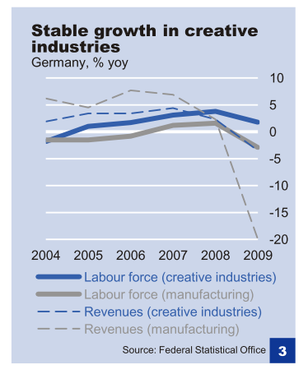
Creative Industries in Germany
Source: Cultural and creative industries: Growth Potential in Specific Segments, Deutsche Bank Research, April 29, 2011, p. 2.
Notes:
6
Employment and labour growth compared to manufacturing - social sustainablity – can the sector create jobs ?
The turnover rate took a negative trend of only -3.5 %, whereas for the manufacturing sector it was of -18%.

Slide 7
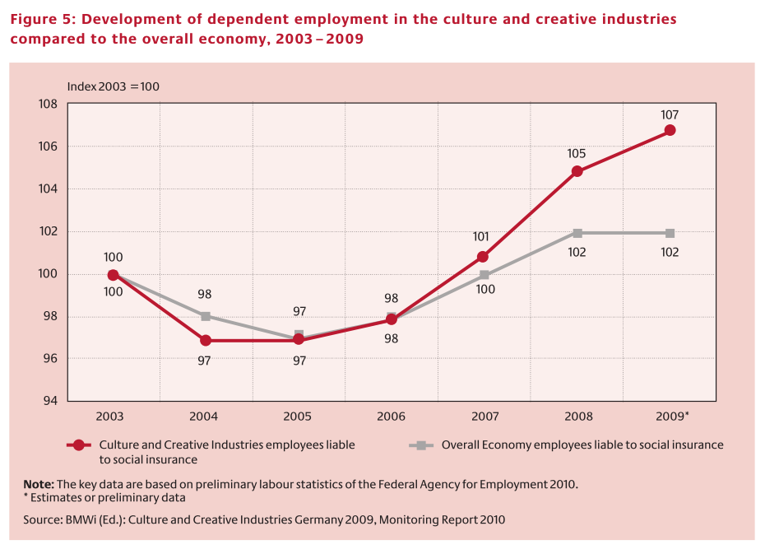
Creative Industries in Germany
Source: Culture and Creative Industries in Germany 2009, Monitoring Report 2010, BMWI, p. 8.
Notes:
7
Employment – comparison with the overall economy
Until 2009, the number of employees has risen by 7 % since 2003.
Labour market situation in the CCIs has grown by 1.8 % between 2008 and 2009, showing a stronger positive trend than the overall economy.

Slide 8
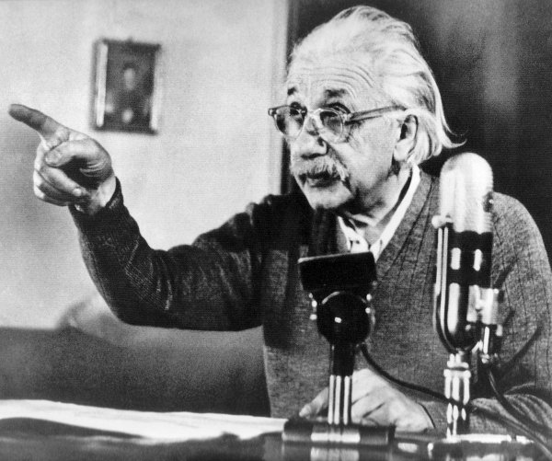
“Not everything that counts can be measured, and not everything that can be measured counts.”
Notes:
The added value of cultural investment - you are investing in social cohesion, in local expression, in the spiritual, the irrational . Preservation of the heritage , memories – encourage disruptive vision –
Life is more than economic wealtht and consumption – it is about shared value and this is the role of cultural policy to substitute for what market forces cannot guarantee or can destroy for the sake of short term profits and persona gains.
Cultureinvestment is about risk taking and great talents get discovered thanks to public investment – no almodovar, luc besson without support to cinemat

Slide 9
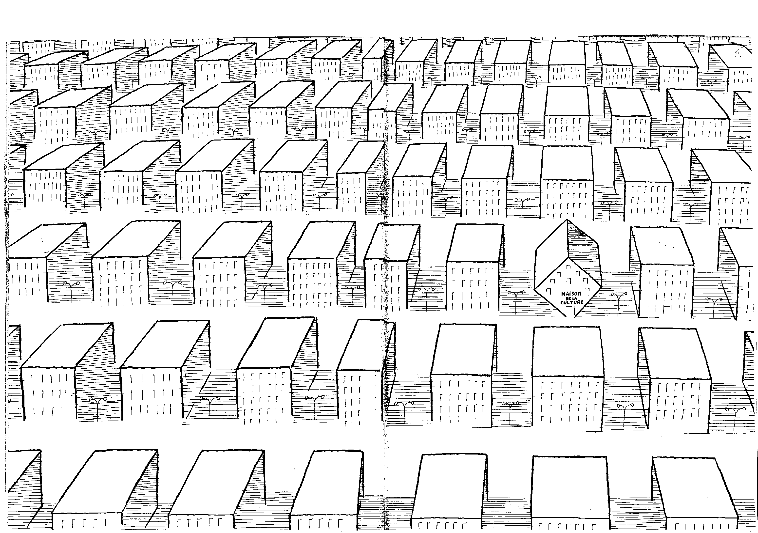
Sempé
Notes:
Second study : Brief is to esbalish a link between creativity and culture. Creativity as a motor of innovation in the economy and society
Can cultural production or art stimulate creativity which in turn will generate sustainalbe jobs and wealth?
Creativity is everywhere – a catchphrase – epitomises success/^progress – attractive / children
Culture is the expression of humans’creativity – knowledge, talents, civilisation -
– creativity is not the monopoly of cultural activities
– not culture as a motor of artistic creativity
Extracts from the elements of creativity – personality , social contexts, psychology what comes from culture and then characterise culture based creativity -

Slide 10
The Components of Culture-based Creativity
ARTISTIC SKILLS
(expertise)
LATERAL THINKING SKILLS
CREATIVITY
A CONDUCIVE ENVIRONMENT
Notes:
Culture based creativity is linked to the ability of people notably artists to think imaginatively, to challenge the conventional to call on the symbolic or the affective – ability to communicate at a different level , to call on aesthetic, , emotions and values or ethic.
To emerge it requires personal abilities(imagination) , technical skills (often artistic skills) , social environment ( society , industries , schools)
Importance for cultural policy to nurture the environment A
Make available cinema, theaters, operas , cultural amenities
Support artistic visions – will enable differentiation , standing out (Beatles for the UK , Abba for Sweden, damien hirst , andy warhol , picasso etc.

Slide 11
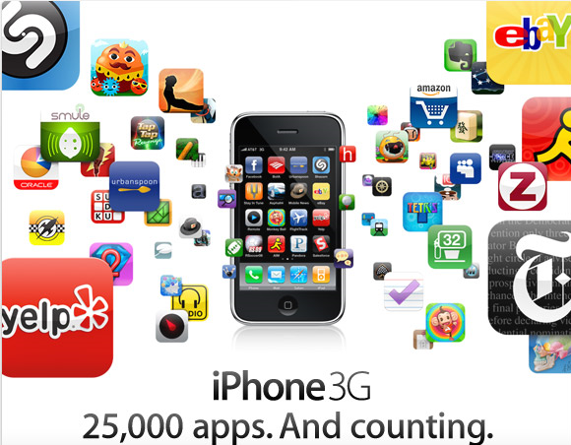
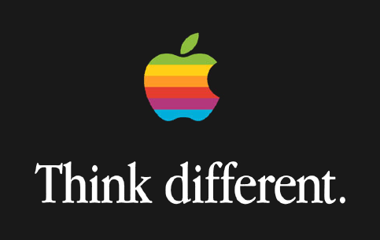
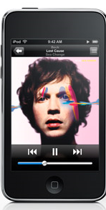

Notes:
Apple illustrate a company that is making use of culture based creativity – design , fun , logo, branding , steve job, Jonathan Ives
European designer esslinger and jonathan ives
Ipod – musc / Pixar animation and technology
IT IS A TECHNOLOGY PRODUCT WITH CULTURE _ STEVE JOB BIOGRAPHY _ MIXING ART AND TECHNOLOGY (polymath)

Slide 12
Creativity – Multi-dimensional
Creativity” is defined as a cross-sector and multidisciplinary way, mixing elements of “artistic creativity”, “economic innovation” as well as “technological innovation.”
Scientific creativity
Technological
creativity
Economic creativity
Cultural creativity
A process of interactions and spill-over effects between different innovative processes
Notes:
Aalto university
Break the barriers , the silos across the disciplines

Slide 13
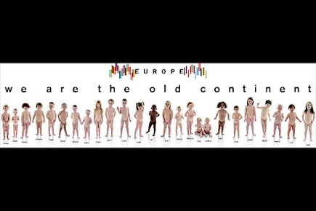
Notes:
Help change the narrative on Europe butalso to realise the cultural ressouces in Europe
Gretat designers , architects , musicians, orchestra, film making
The old continent - publicist of benetton – celebrate diversity / child pornography !
Addressed by international – europe is competitive / China
Addressed by local authorities – regions and cities - opportunities

Slide 14
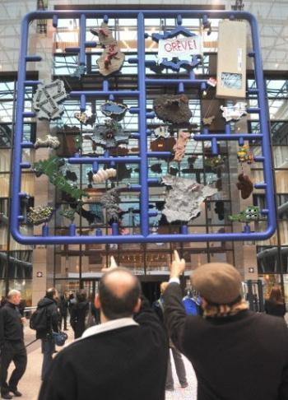
Entropa
Notes:
Daniel Cerny – disruptive way of looking at Europe. Czech presidency

Slide 15
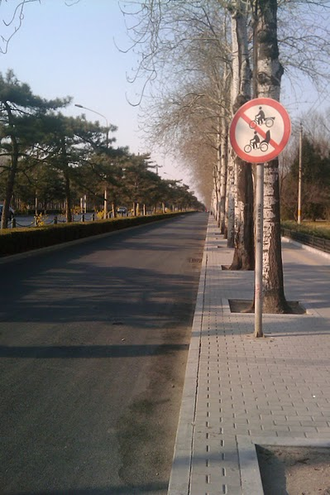
Notes:
CHINA IS TRANSFORMING very rapidly – all car economy
It is now embarked into transforming into a service economy – an economy that rely on innovation , creativity
Culture and creative industries devpt is a policy priority - data are now being collected on the sector.
EUCTP – 25 million euro prog that we opened for the CCIs

Slide 16
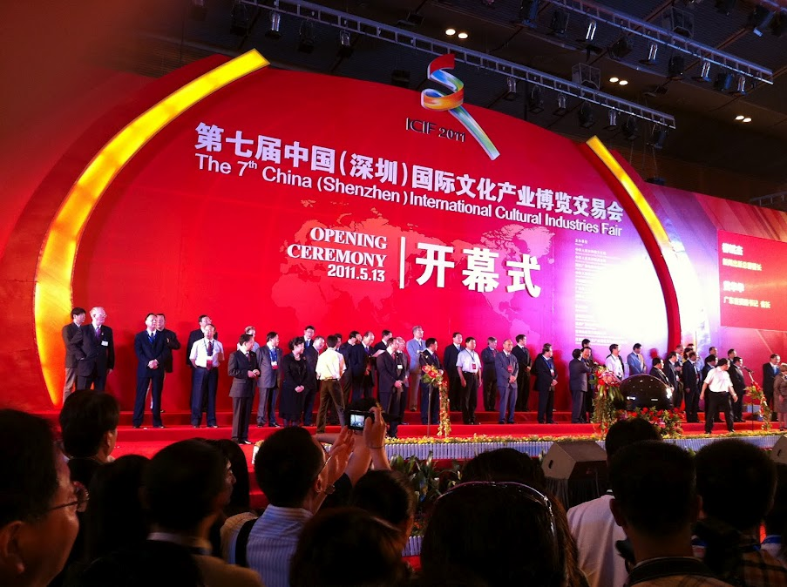
Notes:
CCI trade fairs in shenzhen, beijing
Beijing design week

Slide 17

Awareness -raising
Policy Learning Platform
+ ECIAP.
Information service and guidance
)
Concrete action I
Public-private partnerships on vouchers for innovation support
+ Innova creativity
4CNW
Vinci
FAD-INS
Concrete action II
Public-private partnerships on access to finance
C-I factor
FAME
Concrete action III
Public-private partnerships on cluster excellence & cooperation
ECCL
Cluster 2020
Notes:
EU Regional Policy – 330 bn new programme as from 2014 – 2020 - many initiatives
ECIA – policy dialogue
Typology of culture based investment – EP study (influence future regional policy
CREA-RE slide (policy measure impact – tools )
Mons – culture investment for the local economy and jobs

Slide 18
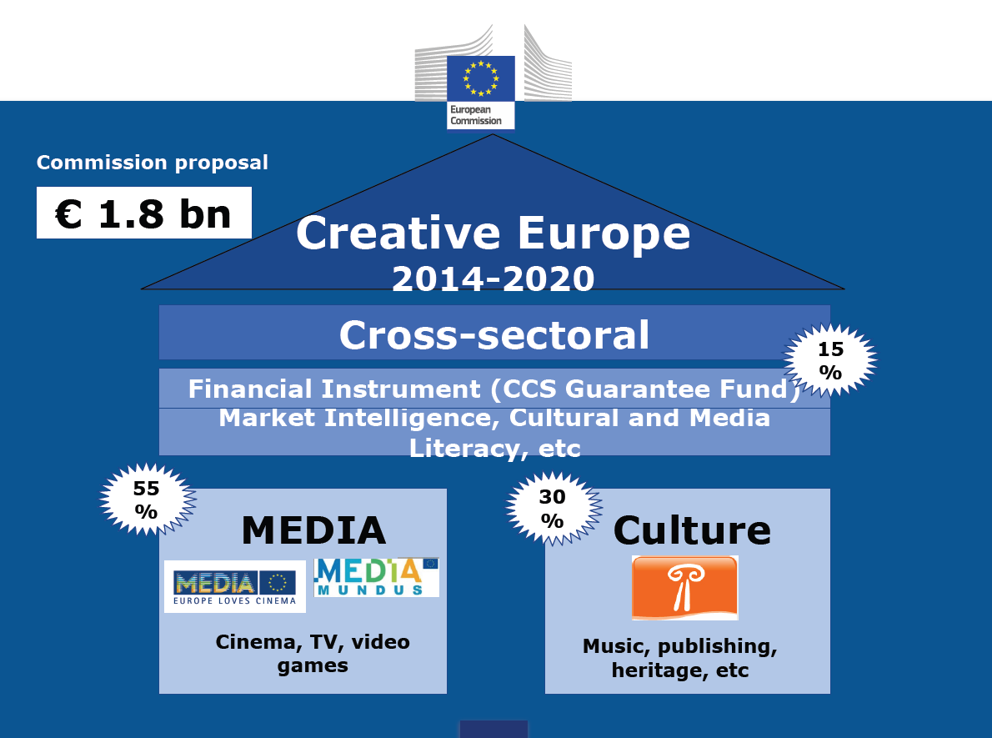
Notes:
New narrative to justify cultural budget at EU level
Significant increase – only a proposal …. Criticised by cultural lobby because its emphasises on the economic dimension

Slide 19
Typology of Culture-based Investment Support:
Cultural skills, education, training to train young talents
Cultural heritage and Craft to mine local cultural ressources
Urban regeneration and social cohesion
Artistic projects and activities to change perceptions and meanings
Cultural and Creative Entrepreneurship/Industries to develop tomorrow ‘s economy
Culture-based creativity , which refers to projects/processes with culture/Art as a source of innovation.
Notes:
We can disinguish different types of culture based investment
Evolution from a cultural policy devoted to maintain cultural flagships , heritage (management of nationalist feelings) , support to local cultural industry to investment with broader meaning
- education
- innovation
- new products and services
- entrepreneurship
- social cohesion
Remarkable is that artistic intervention is at the heart of this policy - either to establish a new climate (desindustrrialisation) , to manage the process (cultural management team – Tartu , to conquer a derelict or abandonned territory ( Arnhem, Nantes) , to empower young talents ….
The ultimate goal is not economic – it is social (a better place to live)

Slide 20
Meanings of culture based-investment support
People - Empowering artists and creative people / support people’s creative vision
-Develop entrepreneurship (Yes I can)
Territory -Urban plannification and reappropriation of territory
Promoting and valuing local heritage (building, languages, traditions)
Economy - Culture lead economic development (with added social and well being value)
Test and experiment tomorrow ‘s economy and industry.
Governance -Valuing long term , cultural participation and artist’s contribution
Support culture beyond subsidies (more fund for the arts , crafts and artists)
Valuing creation to the same extent as innovation .

Slide 21
Culture is a ressource like the environement
NATURE is IN , CULTURE is OUT
The mining and exploitation of cultural ressources (talents, industries, heritage) should be a policy priority to the same extent as environment sustainability.
Notes:
it is not a sector ( excuse for excluding culture from policy priorities in particular on regional policy .
CREA RE – URBACT

Slide 22
IMPACT OF Culture based-investment: ATTRACTIVITY
Retain and form home grown talents .
Become a territory of destination (vs a place of transfer) – Tourism
Improve social well being and social cohesion (self esteem)
Make the most of the local cultural ressources , nurture the distinctive , the exclusive and precious (fight uniformity) .
Urban renovation .
Empower aesthetic, fun, the meaningful

Slide 23
Awareness -raising
Policy Learning Platform
+ ECIAP.
Information service and guidance
)
Concrete action I
Public-private partnerships on vouchers for innovation support
+ Innova creativity
4CNW
Vinci
FAD-INS
Concrete action II
Public-private partnerships on access to finance
C-I factor
FAME
Concrete action III
Public-private partnerships on cluster excellence & cooperation
ECCL
Cluster 2020
Notes:
Help measuring impact
Provide tools
Evidence based

Slide 24
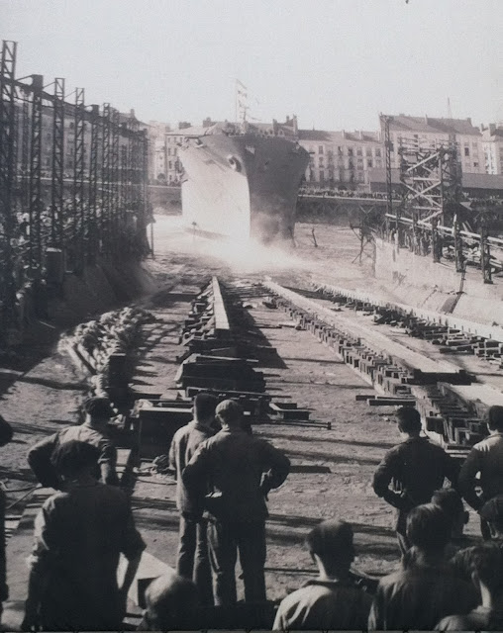
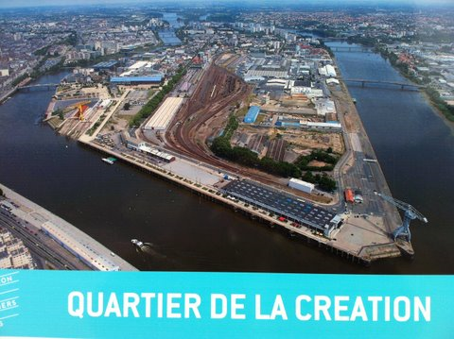
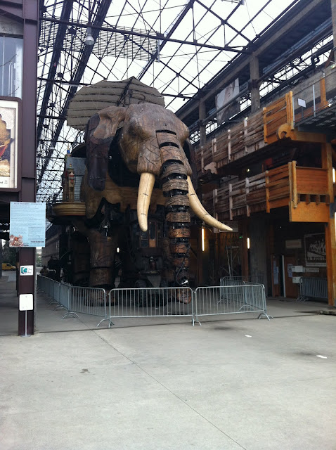
Notes:
Ep study – narrative on cultural investment – regional policy
1987 end of the shipyard / industrial town (18 % of the activity)
Development lead by culture / artists/ Contemporary art for people to reappropiate the zone (festivals) - to learn to see what we keep looking at - change our perception
Architects – urbanist
Zone of economic activity – mixing education and CCIS ( involved in spill over in ECIA )
Elephant – la machine is the Icône (image) - a City of destination (tourism)

Slide 25
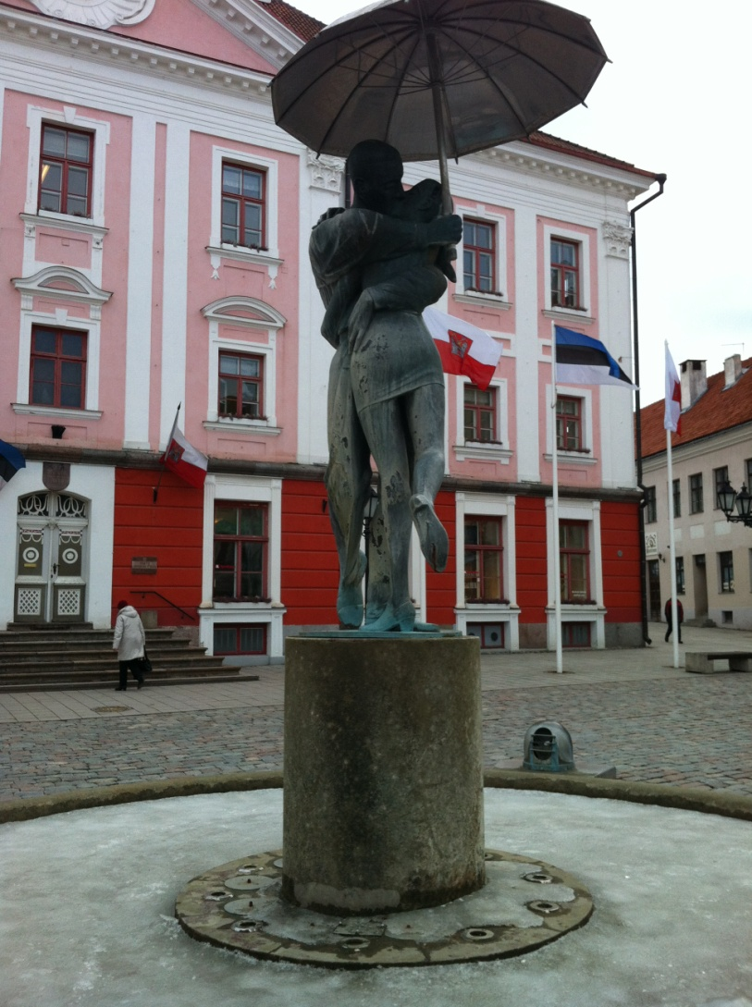
The Spirit of Tartu

Slide 26
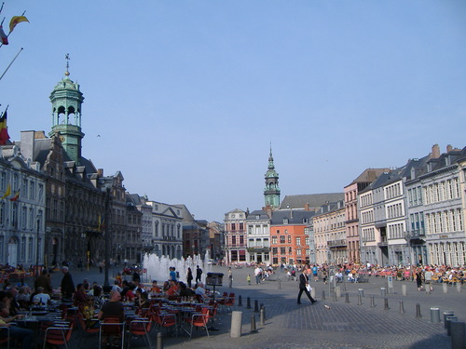
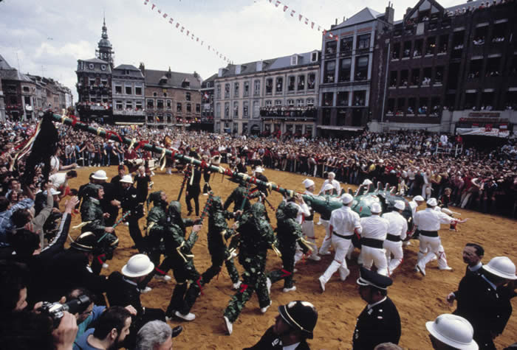
Mons, European Capital of Culture 2015
Culture investment for local economic devpt
Evaluation impact of the investment.
Methodology to measure sustainability of culture investment.
Partnership with local university for local capacity buidling.
Data collection for evidence-based policy.
Notes:
Evaluation of the impact of a 80 million euro investment for the city .

Slide 27
“Creative people do not get the backing they deserve because you can’t put a figure on creative value”.
Ian Livingston, Creative Director Eidos
Notes:
Findings are recent
Policy aspects ?
Specifics non specifics ?

Slide 28
EU support to Creativity and Innovation 2007-2013 (in € billion):
Innovation:
FP7: 53
CIP: 3.6
Structural Funds: 87
Total: 153.6
Culture based Creativity:
CULTURE: 0.4
MEDIA: 0.7
Structural Funds: 6
Total : 7.1
Structural Funds: € 347 billion
Notes:
The study considers the EU creativity policy – it cannot develop an innovation strategy without reflecting on culture based creativity.
Focus is on R&D and technology – Lisbon – 3% of GDP – in general non technology innovation is not looked at.
Creative Europe – more focused

Slide 29
A Creativity Policy Objectives
Encourage imagination and talents at school, in life, in enterprises and public institutions.
Support the development of a creative economy by integrating creativity in innovation policies.
Promote social innovation and inclusion through culture.
Brand your city as a creative place.
Notes:
Policy is really important as the social context influence creativity – we value creativity – do we value culture and art as tool for creativity?
Need to redesign cultural policy and mainstream culture in other policy areas
Art and culture stimulate creativy – imagination / intelligence –

Slide 30
A Creative Region Recommendations
Value culture as an important resource of creativity
Mainstream culture-based creativity in local policies and programmes to foster innovation (economic and social)
Re-direct existing financial resources to stimulate creativity (to support non technology innovation)
Brand the city as THE place to create.
Question and tailor regulatory and institutional supports to creativity and cultural collaboration – redesign cultural policy
Notes:
Essentially we call on mainstreaming cultural policy in regional and technlogy policy. Innovation flagship initiative …
Culture based creativity index – the importance of the environment to stimulate creativity ( in Annex )
Differences are not a bottleneck – enable distinction, the different – that contribute to make Europe a success (cultural dialogue and interactions – this is narrative that should be developped.
How to make the best globalisation – transcend the local identities.

Slide 31
Conclusions : redefine cultural policy ?
Show the importance of artistic talents and cultural activities in the process of innovation, in education , in research (break the silos).
Ensure that innovation policy includes culture-based creativity.
Develop a narrative on cultural policy that go beyond heritage preservation or tourism.
Notes:
Risk of compromission with economic ends – french cultural ministiry opposed to this vision
Estonia / Nordic countries are pushing the boundaries - miniistry of economic and finance
At Eu level – DG Entrepr – ECIA – Stuctural funds , tecnhical assistance programme ( china – turkey – request support as part of accession funding

Slide 32

Notes:
CCIS is a small economic sectore – under ressourced , badly organised , not well represented in Chamber of Commerce , creating small amount of jobs
Individuals , highly competitive , idea sharing is difficult
Universities slow to engage with young entrepeneurs so are financiers ….

Slide 33
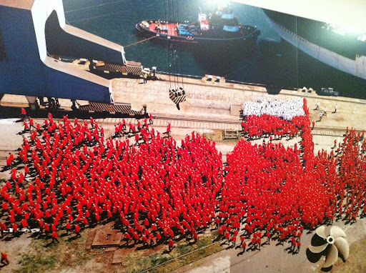

Slide 34
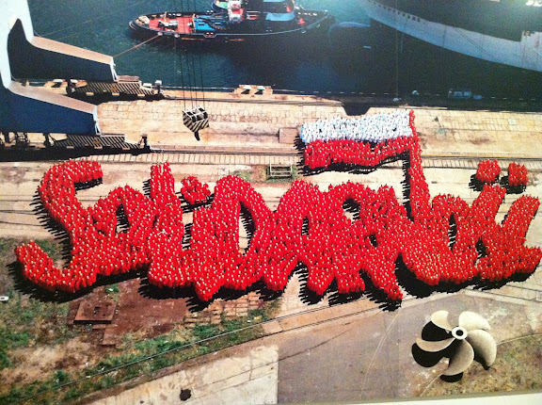

Slide 35
Philippe Kern
Founder and CEO
51 Rue du Trône
B -1050 Brussels
+32 2 289 26 00
pkern@keanet.eu
www.keanet.eu
www.keablog.com
KEA Creative Europe on Linkedin and Facebook
Credits :
Sempé – Le Monde de Sempé (vol1), Edition Denoel
Alan Parker – Making Movies, British Film Institute
Notes:
Creative Europe on Facebook and Linkedin

